Slide 1
NoSQL Theory, Implementations, an introduction Firat Atagun
firat@yahoo-inc.com
http://firatatagun.com

Slide 2
NoSQL
What does it mean?
Not Only SQL.

Slide 3
Use Cases
Massive write performance.
Fast key value look ups.
Flexible schema and data types.
No single point of failure.
Fast prototyping and development.
Out of the box scalability.
Easy maintenance.

Slide 4
Motives Behind NoSQL
Big data.
Scalability.
Data format.
Manageability.

Slide 5
Big Data
Collect.
Store.
Organize.
Analyze.
Share.
Data growth outruns the ability to manage it so we need scalable solutions.

Slide 6
Scalability
Scale up, Vertical scalability.
Increasing server capacity.
Adding more CPU, RAM.
Managing is hard.
Possible down times

Slide 7
Scalability
Scale out, Horizontal scalability.
Adding servers to existing system with little effort, aka Elastically scalable.
Bugs, hardware errors, things fail all the time.
It should become cheaper. Cost efficiency.
Shared nothing.
Use of commodity/cheap hardware.
Heterogeneous systems.
Controlled Concurrency (avoid locks).
Service Oriented Architecture. Local states.
Decentralized to reduce bottlenecks.
Avoid Single point of failures.
Asynchrony.
Symmetry, you don’t have to know what is happening. All nodes should be symmetric.

Slide 8
What is Wrong With RDBMS?
Nothing. One size fits all? Not really.
Impedance mismatch.
Object Relational Mapping doesn't work quite well.
Rigid schema design.
Harder to scale.
Replication.
Joins across multiple nodes? Hard.
How does RDMS handle data growth? Hard.
Need for a DBA.
Many programmers are already familiar with it.
Transactions and ACID make development easy.
Lots of tools to use.

Slide 9
ACID Semantics
Atomicity: All or nothing.
Consistency: Consistent state of data and transactions.
Isolation: Transactions are isolated from each other.
Durability: When the transaction is committed, state will be durable.
Any data store can achieve Atomicity, Isolation and Durability but do you always need consistency? No.
By giving up ACID properties, one can achieve higher performance and scalability.

Slide 10
Enter CAP Theorem
Also known as Brewer’s Theorem by Prof. Eric Brewer, published in 2000 at University of Berkeley.
“Of three properties of a shared data system: data consistency, system availability and tolerance to network partitions, only two can be achieved at any given moment.”
Proven by Nancy Lynch et al. MIT labs.
http://www.cs.berkeley.edu/~brewer/cs262b-2004/PODC-keynote.pdf

Slide 11
CAP Semantics
Consistency: Clients should read the same data. There are many levels of consistency.
Strict Consistency – RDBMS.
Tunable Consistency – Cassandra.
Eventual Consistency – Amazon Dynamo.
Availability: Data to be available.
Partial Tolerance: Data to be partitioned across network segments due to network failures.
Notes:
N : Number of nodes with a replica of data.
W: Number of nodes that must acknowledge the update.
R : Minimum number of nodes that succeeds read operation.
W + R > N Strong Consistency
W + R <= N Weak Consistency

Slide 12
A Simple Proof
Consistent and available
No partition.
App
Data
Data
A
B

Slide 13
A Simple Proof
Available and partitioned
Not consistent, we get back old data.
App
Data
Old Data
A
B

Slide 14
A Simple Proof
Consistent and partitioned
Not available, waiting…
App
New Data
Wait for new data
A
B

Slide 15
BASE, an ACID Alternative
Almost the opposite of ACID.
Basically available: Nodes in the a distributed environment can go down, but the whole system shouldn’t be affected.
Soft State (scalable): The state of the system and data changes over time.
Eventual Consistency: Given enough time, data will be consistent across the distributed system.

Slide 16
A Clash of cultures
ACID:
Strong consistency.
Less availability.
Pessimistic concurrency.
Complex.
BASE:
Availability is the most important thing. Willing to sacrifice for this (CAP).
Weaker consistency (Eventual).
Best effort.
Simple and fast.
Optimistic.

Slide 17
Distributed Transactions
Two phase commit.
Starbucks doesn’t use two phase commit by Gregor Hophe.
Possible failures
Network errors.
Node errors.
Database errors.
Problems:
Locking the entire cluster if one node is down
Possible to implement timeouts.
Possible to use Quorum.
Quorum: in a distributed environment, if there is
partition, then the nodes vote to commit or rollback.
Commit
Rollback
Coordinator
Acknowledge
Complete operation
Release locks

Slide 18
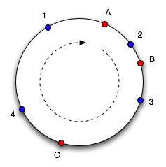
Consistent Hashing
Solves Partitioning Problem.
Consistent Hashing, Memcahced.
servers = [s1, s2, s3, s4, s5]
serverToSendData = servers[hash(data) % servers.length]
A New Hope
Continuum Approach.
Virtual Nodes in a cycle.
Hash both objects and caches.
Easy Replication.
Eventually Consistent.
What happens if nodes fail?
How do you add nodes?
http://www.akamai.com/dl/technical_publications/ConsistenHashingandRandomTreesDistributedCachingprotocolsforrelievingHotSpotsontheworldwideweb.pdf

Slide 19
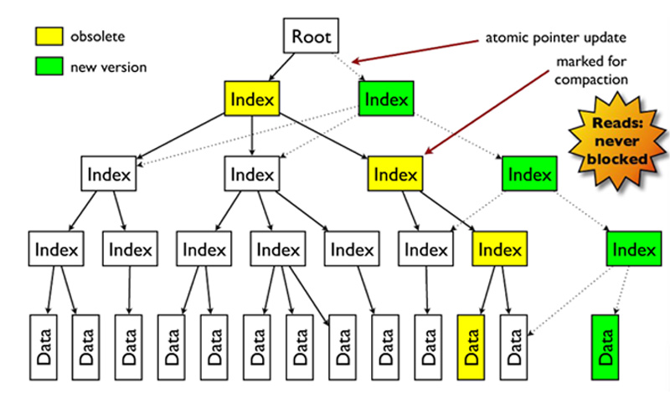
Concurrency models
Optimistic concurrency.
Pessimistic concurrency.
MVCC.

Slide 20
Vector Clocks
Used for conflict detection of data.
Timestamp based resolution of conflicts is not enough.
Time 1:
Time 2:
Replicated
Time 3:
Update
Time 4:
Update
Time 5:
Replicated
Conflict detection

Slide 21
Vector Clocks
A
Document.v.1([A, 1])
Update
A
Document.v.2([A, 2])
B
C
Document.v.2([A, 2],[B,1])
Document.v.2([A, 2],[C,1])
Conflicts are detected.

Slide 22
Read Repair
Value = Data.v2
Client
GET (K, Q=2)
Value = Data.v2
Update K = Data.v2
Value = Data.v1

Slide 23
Gossip Protocol & Hinted Handoffs
Most preferred communication protocol in a distributed environment is Gossip Protocol.
D
All the nodes talk to each other peer wise.
There is no global state.
No single point of coordinator.
If one node goes down and there is a Quorum
load for that node is shared among others.
Self managing system.
If a new node joins, load is also distributed.
A
G
H
B
Requests coming to F will be handled by
the nodes who takes the load of F, lets say C with
the hint that it took the requests which was for F,
when F becomes available, F will get this
Information from C. Self healing property.
C
F

Slide 24
Data Models
Key/Value Pairs.
Tuples (rows).
Documents.
Columns.
Objects.
Graphs.
There are corresponding data stores.

Slide 25
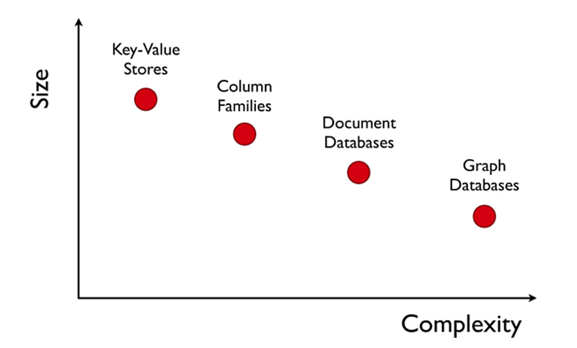
Complexity

Slide 26
Key-Value Stores
Memcached – Key value stores.
Membase – Memcached with persistence and improved consistent hashing.
AppFabric Cache – Multi region Cache.
Redis – Data structure server.
Riak – Based on Amazon’s Dynamo.
Project Voldemort – eventual consistent key value stores, auto scaling.

Slide 27
Memcached
Very easy to setup and use.
Consistent hashing.
Scales very well.
In memory caching, no persistence.
LRU eviction policy.
O(1) to set/get/delete.
Atomic operations set/get/delete.
No iterators, or very difficult.

Slide 28
Membase
Easy to manage via web console.
Monitoring and management via Web console .
Consistency and Availability.
Dynamic/Linear Scalability, add a node, hit join to cluster and rebalance.
Low latency, high throughput.
Compatible with current Memcached Clients.
Data Durability, persistent to disk asynchronously.
Rebalancing (Peer to peer replication).
Fail over (Master/Slave).
vBuckets are used for consistent hashing.
O(1) to set/get/delete.

Slide 29
Redis
Distributed Data structure server.
Consistent hashing at client.
Non-blocking I/O, single threaded.
Values are binary safe strings: byte strings.
String : Key/Value Pair, set/get. O(1) many string operations.
Lists: lpush, lpop, rpush, rpop.you can use it as stack or queue. O(1). Publisher/Subscriber is available.
Set: Collection of Unique elements, add, pop, union, intersection etc. set operations.
Sorted Set: Unique elements sorted by scores. O(logn). Supports range operations.
Hashes: Multiple Key/Value pairs
HMSET user 1 username foo password bar age 30
HGET user 1 age

Slide 30
Microsoft AppFabric
Add a node to the cluster easily. Elastic scalability.
Namespaces to organize different caches.
LRU Eviction policy.
Timeout/Time to live is default to 10 min.
No persistence.
O(1) to set/get/delete.
Optimistic and pessimistic concurrency.
Supports tagging.

Slide 31
Document Stores
Schema Free.
Usually JSON like interchange model.
Query Model: JavaScript or custom.
Aggregations: Map/Reduce.
Indexes are done via B-Trees.

Slide 32
Mongodb
Data types: bool, int, double, string, object(bson), oid, array, null, date.
Database and collections are created automatically.
Lots of Language Drivers.
Capped collections are fixed size collections, buffers, very fast, FIFO, good for logs. No indexes.
Object id are generated by client, 12 bytes packed data. 4 byte time, 3 byte machine, 2 byte pid, 3 byte counter.
Possible to refer other documents in different collections but more efficient to embed documents.
Replication is very easy to setup. You can read from slaves.

Slide 33
Mongodb
Connection pooling is done for you. Sweet.
Supports aggregation.
Map Reduce with JavaScript.
You have indexes, B-Trees. Ids are always indexed.
Updates are atomic. Low contention locks.
Querying mongo done with a document:
Lazy, returns a cursor.
Reduceable to SQL, select, insert, update limit, sort etc.
There is more: upsert (either inserts of updates)
Several operators:
$ne, $and, $or, $lt, $gt, $incr,$decr and so on.
Repository Pattern makes development very easy.

Slide 34
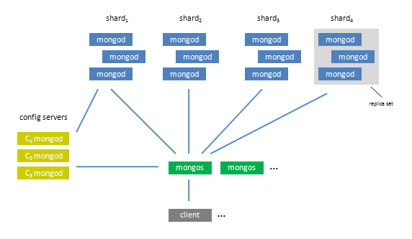
Mongodb - Sharding
Config servers: Keeps mapping
Mongos: Routing servers
Mongod: master-slave replicas

Slide 35
Couchdb
Availability and Partial Tolerance.
Views are used to query. Map/Reduce.
MVCC – Multiple Concurrent versions. No locks.
A little overhead with this approach due to garbage collection.
Conflict resolution.
Very simple, REST based. Schema Free.
Shared nothing, seamless peer based Bi-Directional replication.
Auto Compaction. Manual with Mongodb.
Uses B-Trees
Documents and indexes are kept in memory and flushed to disc periodically.
Documents have states, in case of a failure, recovery can continue from the state documents were left.
No built in auto-sharding, there are open source projects.
You can’t define your indexes.

Slide 36
Object Stores
Objectivity.
Db4o.

Slide 37
Objectivity
No need for ORM. Closer to OOP.
Complex data modeling.
Schema evolution.
Scalable Collections: List, Set, Map.
Object relations.
Bi-Directional relations
ACID properties.
Blazingly fast, uses paging.
Supports replication and clustering.

Slide 38
Column Stores
Row oriented
Id | username | email | Department
1 | John | john@foo.com | Sales
2 | Mary | mary@foo.com | Marketing
3 | Yoda | yoda@foo.com | IT
Column oriented
Id
1
2
3
Username
John
Mary
Yoda
email
john@foo.com
mary@foo.com
yoda@foo.com
Department
Sales
Marketing
IT

Slide 39
Cassandra
Tunable consistency.
Decentralized.
Writes are faster than reads.
No Single point of failure.
Incremental scalability.
Uses consistent hashing (logical partitioning) when clustered.
Hinted handoffs.
Peer to peer routing(ring).
Thrift API.
Multi data center support.

Slide 40
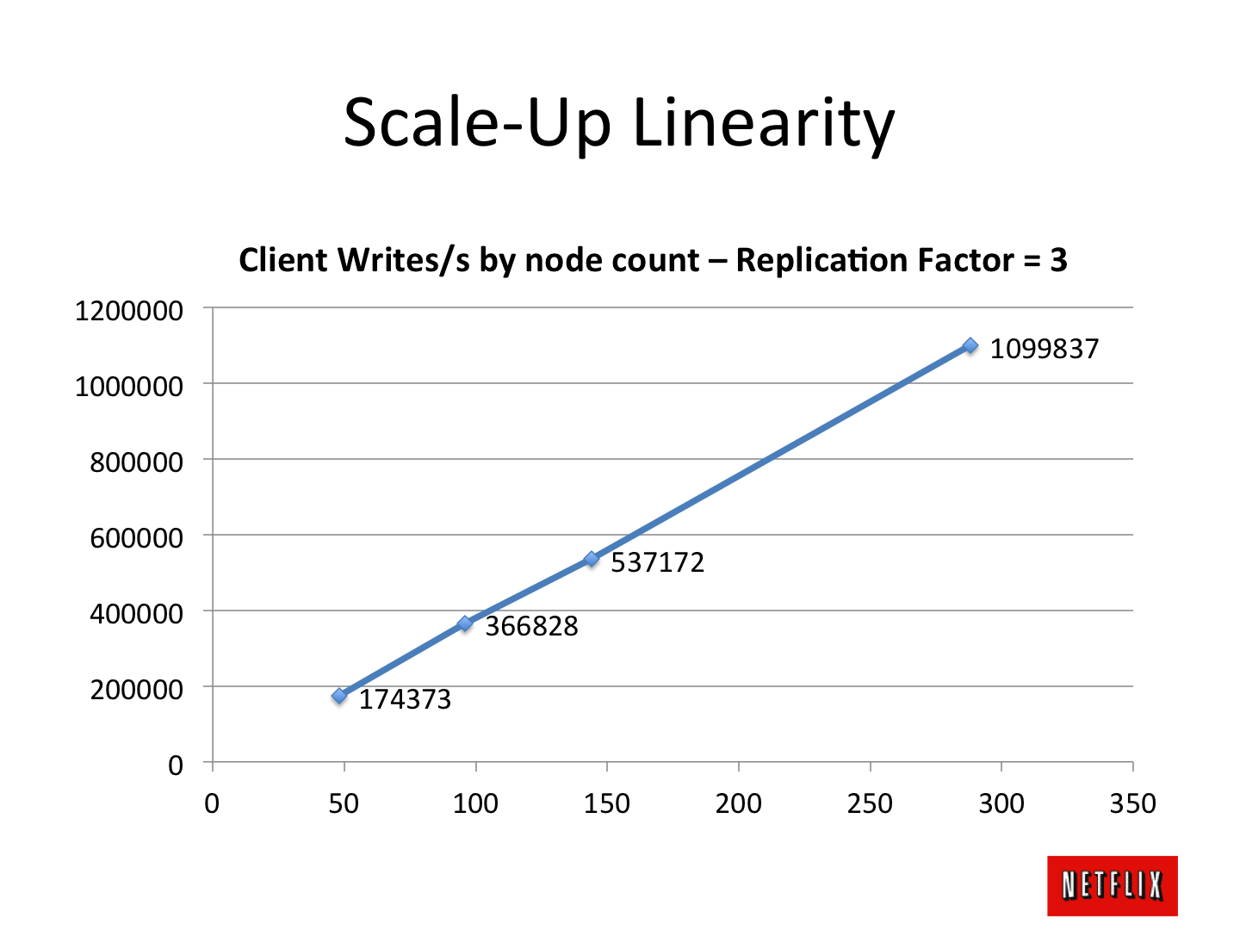
Cassandra at Netflix
http://techblog.netflix.com/2011/11/benchmarking-cassandra-scalability-on.html

Slide 41

Graph Stores
Based on Graph Theory.
Scale vertically, no clustering.
You can use graph algorithms easily.

Slide 42
Neo4J
Nodes, Relationship.
Traversals.
HTTP/REST.
ACID.
Web Admin.
Not too much support for languages.
Has transactions.

Slide 43
Which one to use?
Key-value stores:
Processing a constant stream of small reads and writes.
Document databases:
Natural data modeling. Programmer friendly. Rapid development. Web friendly, CRUD.
RDMBS:
OLTP. SQL. Transactions. Relations.
OODBMS
Complex object models.
Data Structure Server:
Quirky stuff.
Columnar:
Handles size well. Massive write loads. High availability. Multiple-data centers. MapReduce
Graph:
Graph algorithms and relations.
Want more ideas ?
http://highscalability.com/blog/2011/6/20/35-use-cases-for-choosing-your-next-nosql-database.html

Slide 44
Thank you.

